Slide 1
DETECTION OF MALARIAL INFECTED CELLS USING CONVOLUTIONAL NEURAL NETWORKS
ANAND E(312319106010)
GOKUL KS (312319106046)
MENTOR:
Dr. K. VENKATESAN M.E., Ph.D.
SUPERVISOR
ASSISTANT PROFESSOR

Slide 2
Motive:
Even though malaria has been around for more than a century, it continues to claim a sizable number of lives each year. Innovations in malaria treatment are now possible thanks to the development of artificial intelligence.
The prevention, detection, and treatment of disease can all be improved by applying machine learning techniques to this field.

Slide 3
Objective:
The classification of thin blood smear images of the potentially infected cells is used in this work to develop convolutional neural networks for the detection of malaria. Images were segmented, files were organized, image sizes were standardized, colour channels were adjusted, and data was split during the preprocessing of the input data.
The suggested methodology also included image conversion, defining the network architecture, fine-tuning the parameters, and network training. Convolutional neural network architectures of different types were created and assessed. Multiple values of various network layer parameters were also evaluated.
The proposed network architecture starts with two convolutional and pooling layers, then two linear layers, activation functions, and batch normalization. The best outcomes were produced by this artificial neural network, which had an accuracy rate of 97%.

Slide 4
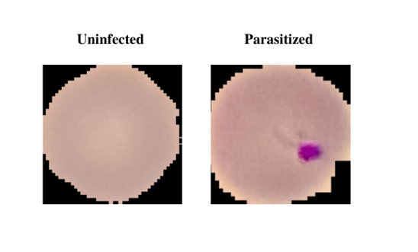
DATASET:
The data set is taken from an official website. It contains 2 features about 13,000 Malaria cell Images, and it is classified into two types:
Infected
Non-Infected
This Dataset is taken from the official NIH Website:
https://ceb.nlm.nih.gov/repositories/malaria-datasets/

Slide 5
LITERATURE REVIEW :
TITLE | YEAR | AUTHOR | DESCRIPTION
Convolutional neural network based malaria diagnosis from focus stack of blood smear images acquired using custom built slide scanner | 2018 | Gopakumar GP, Swetha M, Sai Siva G and Sai Subrahmanyam GRK | In this study, we present a CNN-based approach for malaria diagnosis using a custom-built slide scanner to acquire focus stacks of blood smear images. A focus stack is a collection of images taken at different focal depths and combined to produce a single image with increased depth of field. The slide scanner used in this study is capable of acquiring high-resolution focus stacks of blood smears. The images are pre-processed to enhance contrast and remove noise before being fed into the CNN. The CNN consists of multiple convolutional and pooling layers followed by fully connected layers that classify the image into infected or uninfected categories.

Slide 6
Improving Malaria Parasite Detection from Red Blood Cell Using Deep Convolutional Neural Networks | 2019 | A. Rahman, H. Zunair, M. S. Rahman | The proposed method has the potential to significantly improve the accuracy and speed of malaria diagnosis, particularly in resource-limited settings where access to skilled personnel and diagnostic tools is limited. The CNN-based approach can be integrated with automated image analysis systems to provide a reliable and efficient solution for malaria diagnosis.

Slide 7
Malaria parasite detection from peripheral blood smear images using deep belief networks | 2017 | Bibin, M. S. Nair, and P. Punitha | This project proposes the introduction of the deep learning concept called the convolutional neural network and using a convolutional network finding the accuracy of the infected or not infected blood cell. So, the concept of building the scratch convolutional neural network is used in our proposed work and other convolutional neural networks
Automated image processing method for the diagnosis and classification of malaria on thin blood smears | 2019 | Nicholas E. Ross., Charles J. Pitchard., David M. Rubin and Adriano G. Duse | He introduced the backpropagation feedforward neural network concept. The learning rate of this project was higher than the basic convolutional neural network. So, understanding the concept of the neural network used in that model

Slide 8
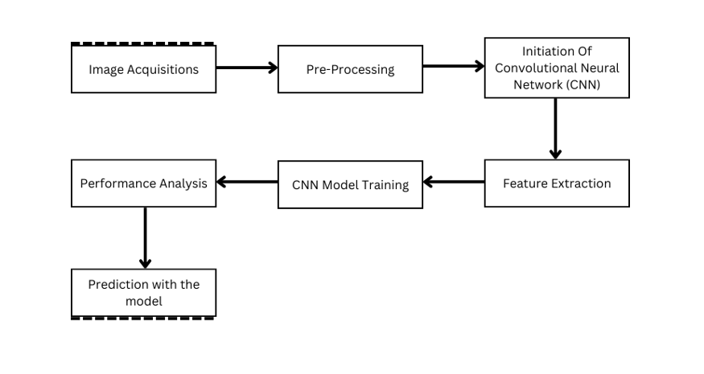
Operation Process:

Slide 9
PROCESS FLOW & ALGORITHM:
Step 1: Gather the data elements and combine them into a file
system for simple transportation.
Step 2: Data Augmentation is performed with the batch size of
64.
Step 3: Build the Basic CNN model from scratch, which is
made up of CNN layers and a fully - connected dense layer,
once construction is accomplished then fit the model.
Step 6: Proceed to utilize the Tensor Flow and Keras package
to run the model after inputting the images.
Step 7: Use Epoch = (number of iterations * batch size) / total
number of images in training.
Step 8: Perform visualization and Performance metrics
analysis.
Step 9: Check the accuracy, if it is not sufficient improve the
model by tuning hyperparameters etc.
Step 10: Finally, the optimized model is implied for
prediction.

Slide 10
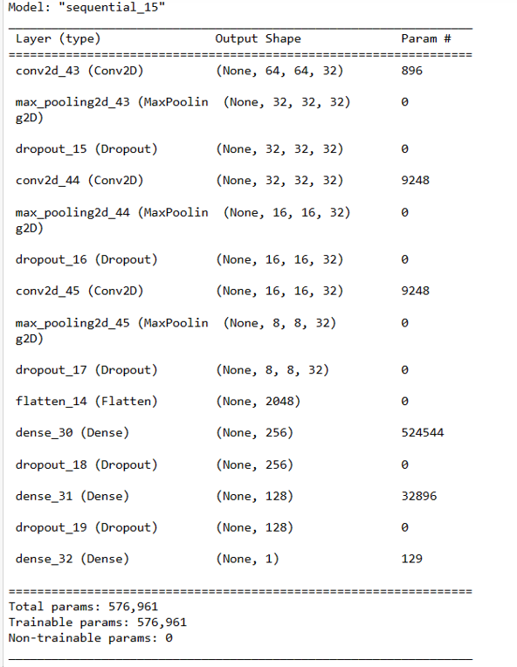
Model Architecture :

Slide 11
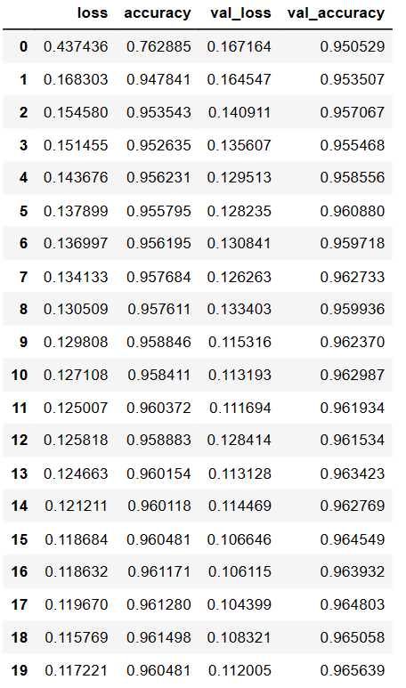
Accuracy during Training:

Slide 12
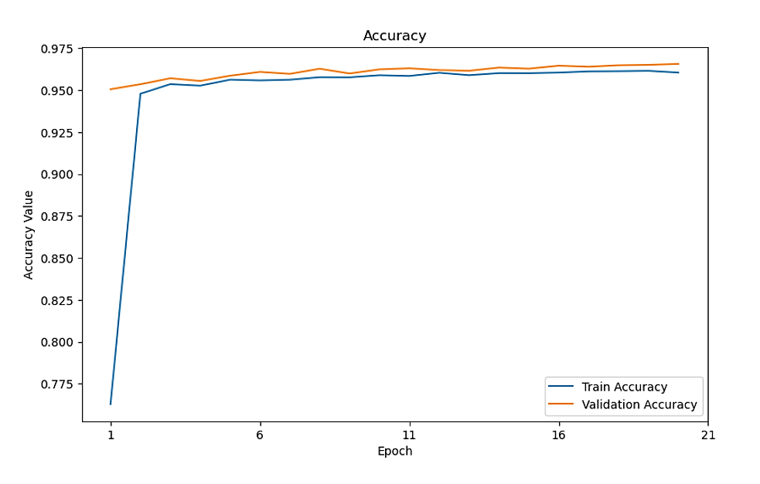
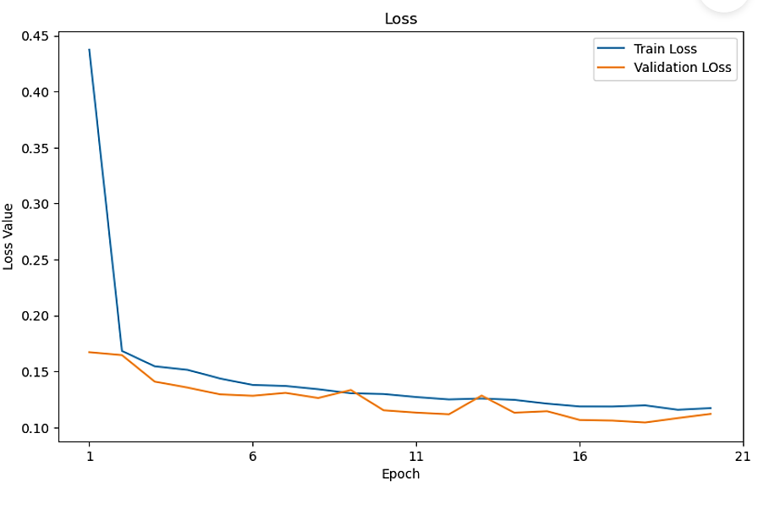
Accuracy & Loss Graph

Slide 13
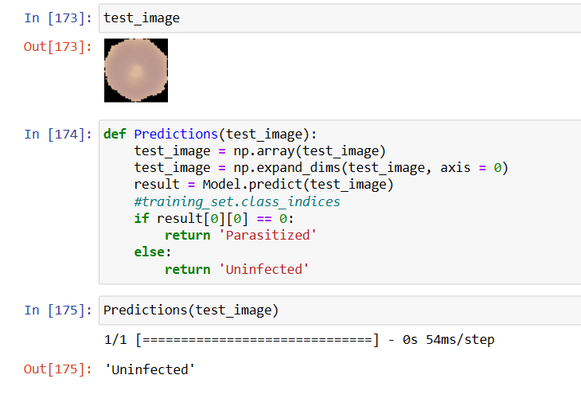
Prediction with model :

Slide 14
REFERENCE
Adán Antonio Alonso-Ramírez; Tat’y Mwata-Velu; Carlos Hugo García-Capulín; Horacio Rostro-González;Juan Prado-Olivarez; Marcos Gutiérrez-López; Alejandro Israel Barranco-Gutiérrez “Classifying Parasitized and Uninfected Malaria Red Blood Cells Using Convolutional-Recurrent Neural Networks”(2022)
Muhammad Umer; Saima Sadiq; Muhammad Ahmad; Saleem Ullah; Gyu Sang Choi; Arif Mehmood “A Novel Stacked CNN for Malarial Parasite Detection in Thin Blood Smear Images”(2020).
Arindam B. Chowdhury; Jeremy Roberson; Ajat Hukkoo; Srinivas Bodapati; David J. Cappelleri “Automated Complete Blood Cell Count and Malaria Pathogen Detection Using Convolution Neural Network”(2020)

